Slide 1
Artificial Intelligence Risks
and how to tell them apart
Dr Shahar Avin
sa478@cam.ac.uk

Slide 2
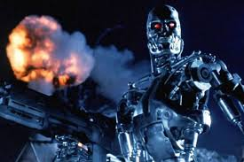
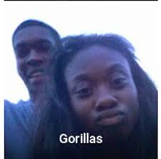

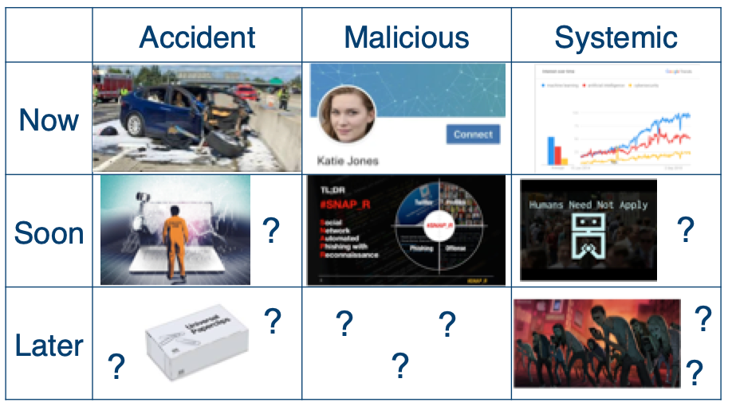

Aim of the talk

Slide 3
Risk classification framework
 | Accident | Malicious | Systemic
Now
Soon
Later

Slide 4
 | Accident | Malicious | Systemic
Now
Soon
Later

Slide 5
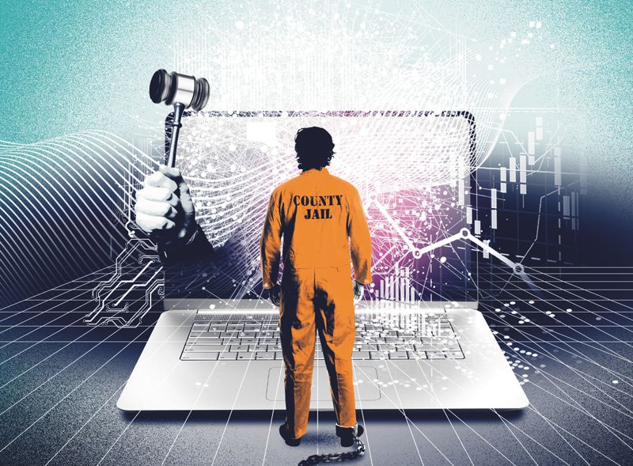

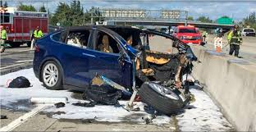
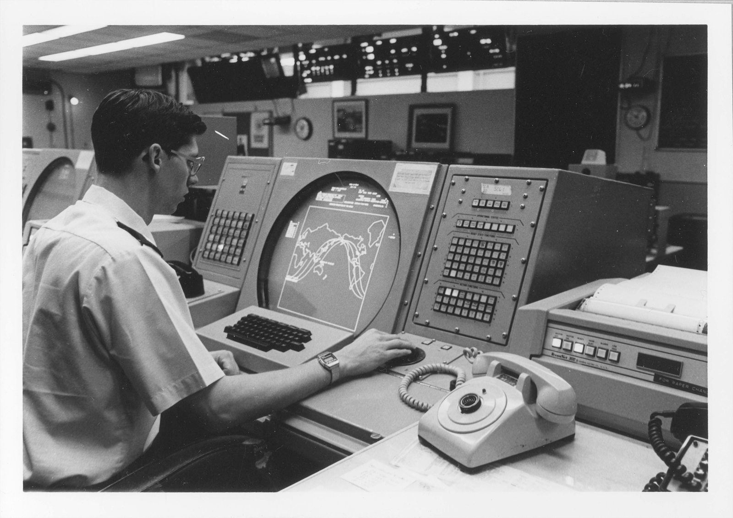
Accident risks
?
?
?
?

Slide 6
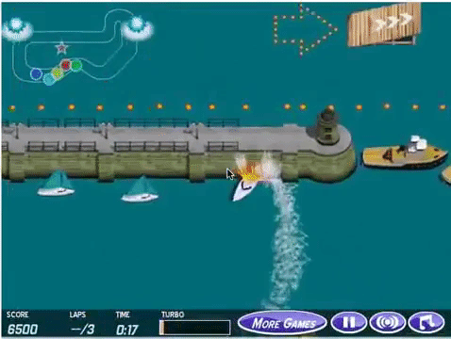

Technical accident risk research

Slide 7
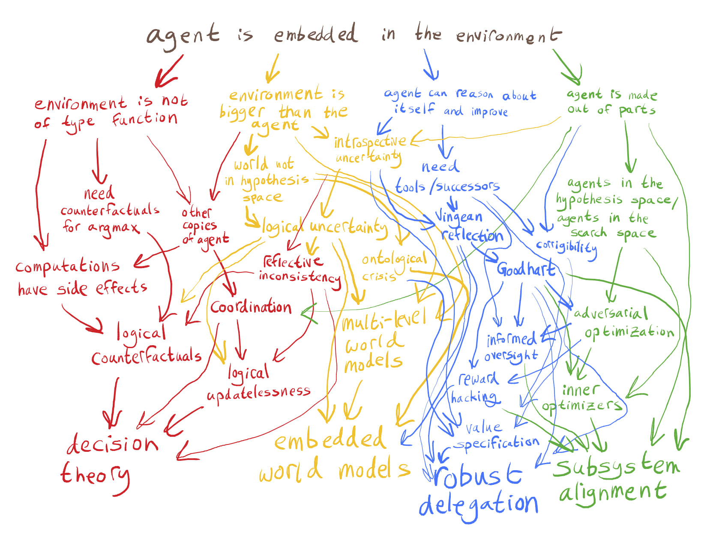
Long-term accident risk research

Slide 8
 | Accident | Malicious | Systemic
Now
Soon
Later
?
?
?

Slide 9
 | Accident | Malicious | Systemic
Now
Soon
Later
?
?
?

Slide 10
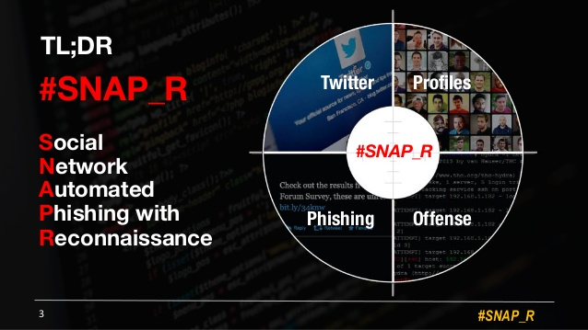
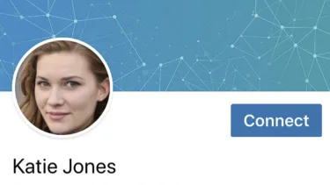
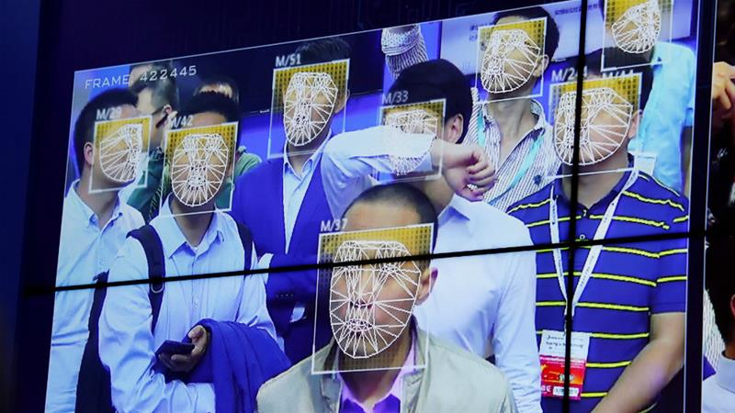
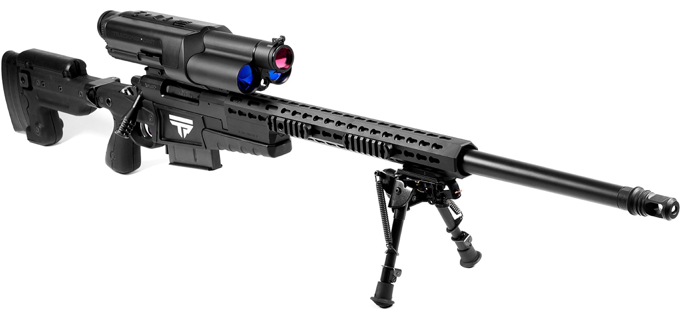
Malicious use risks
?
?
?
?
?
?
?

Slide 11
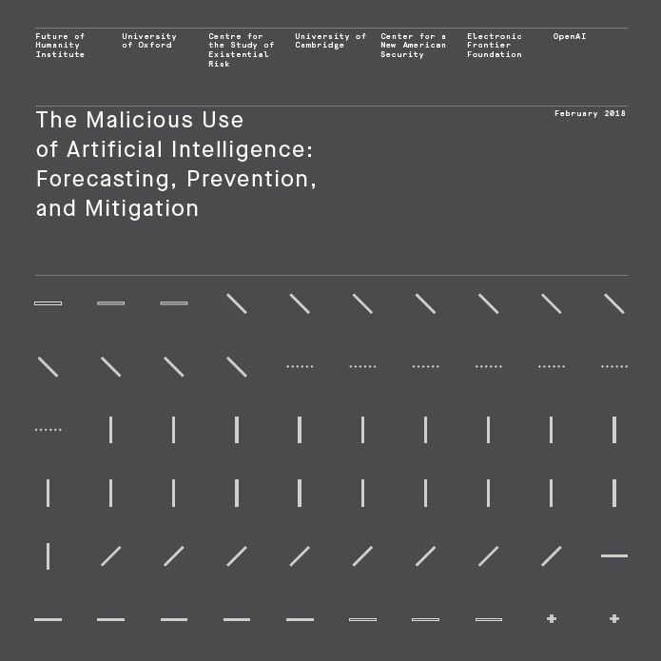
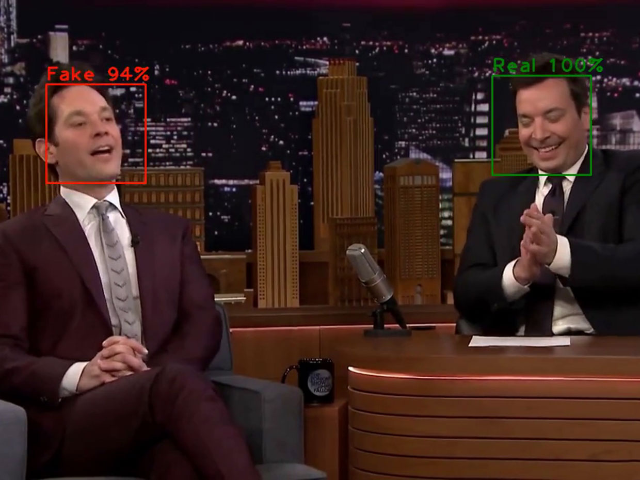
Malicious use research

Slide 12
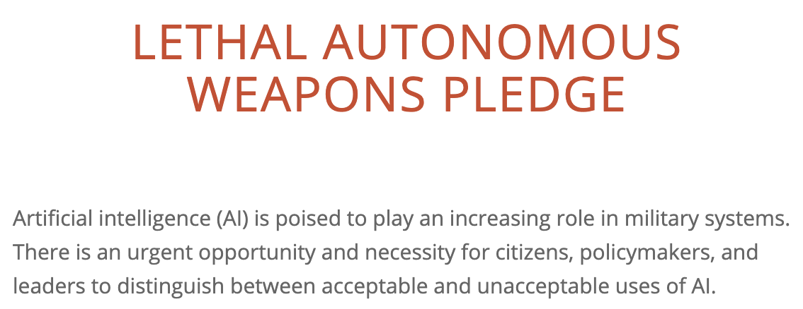
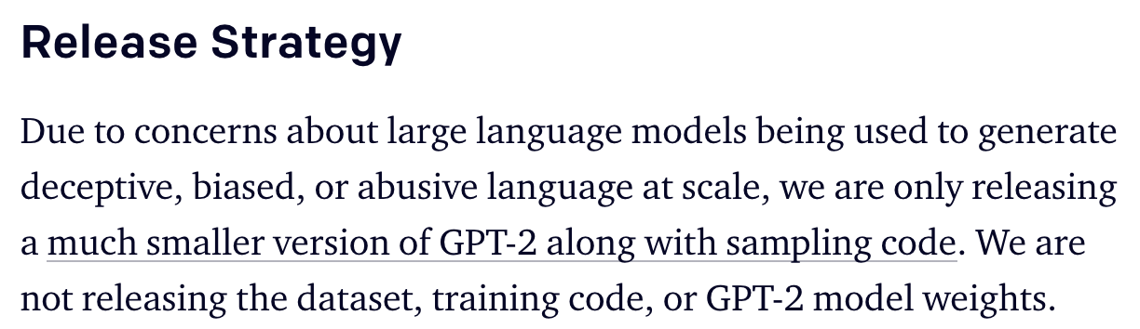
Malicious use norms

Slide 13
 | Accident | Malicious | Systemic
Now
Soon
Later
?
?
?
?
?
?

Slide 14
 | Accident | Malicious | Systemic
Now
Soon
Later
?
?
?
?
?
?

Slide 15
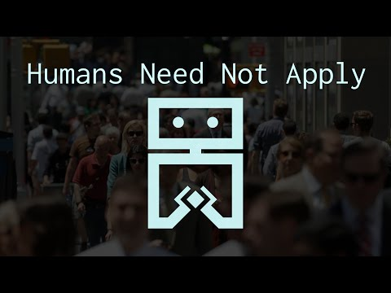
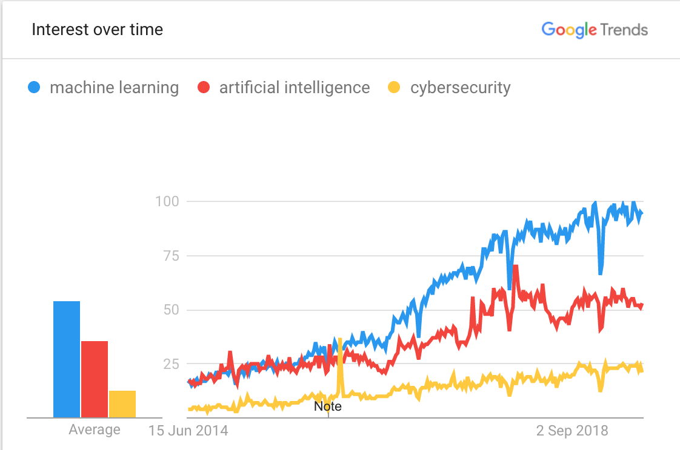
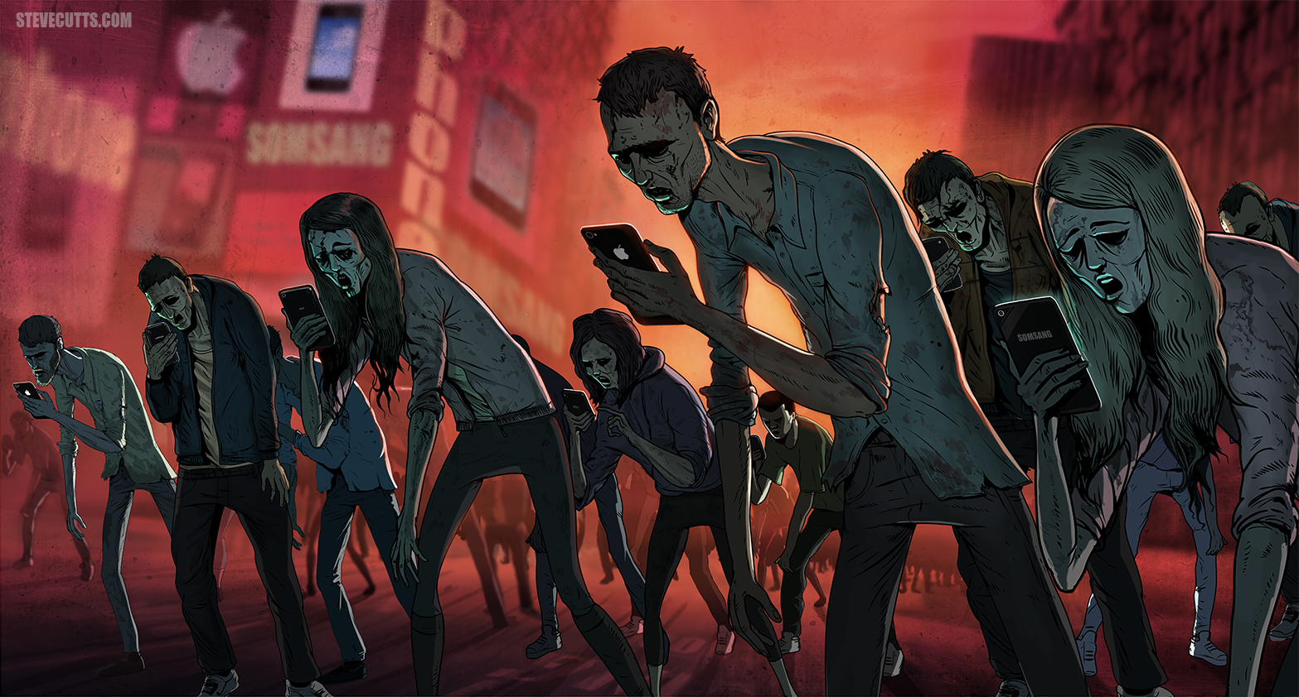
Systemic risks
?
?
?
?
?
?

Slide 16
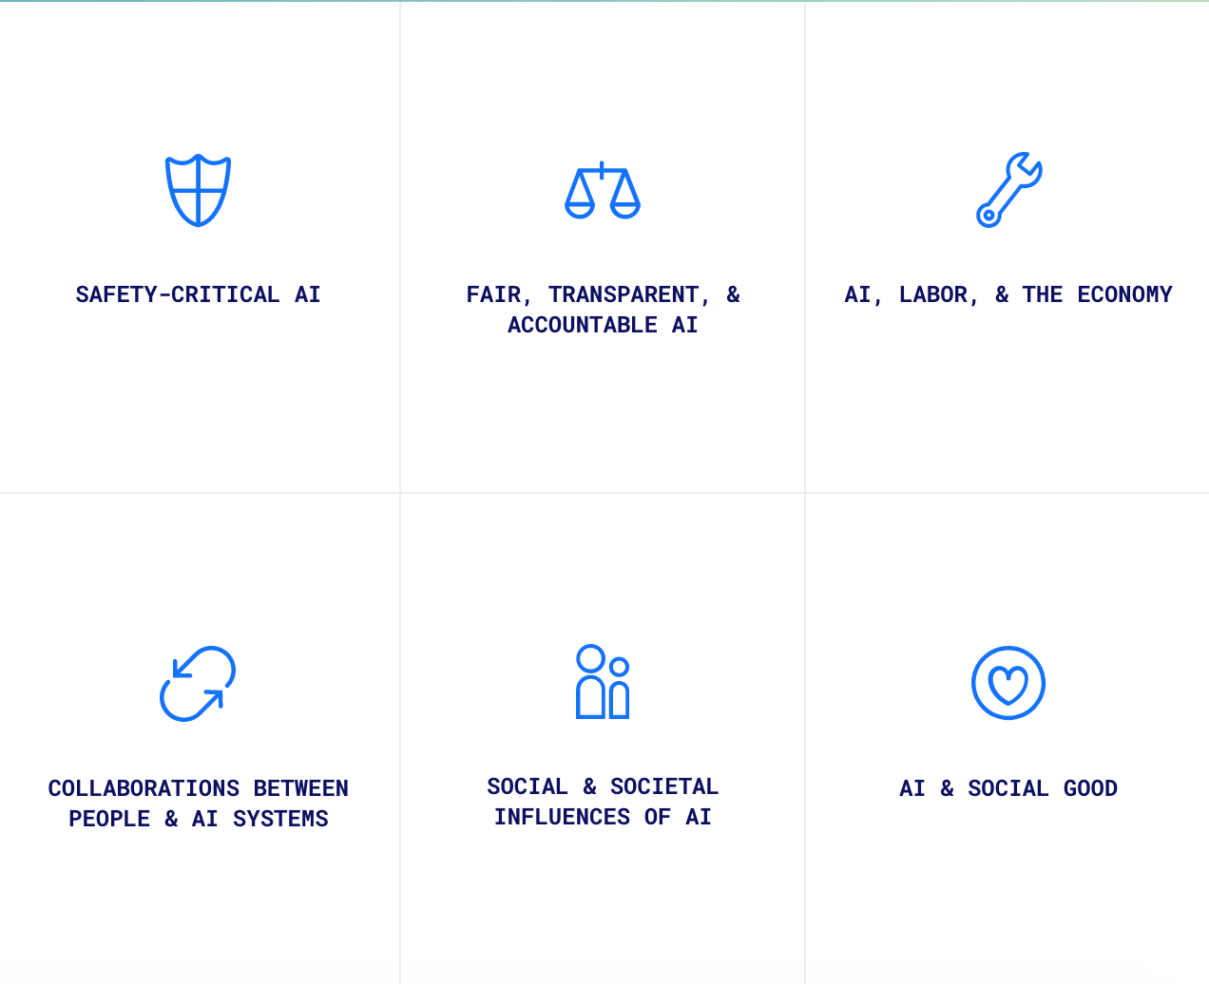
Addressing systemic risks

Slide 17
 | Accident | Malicious | Systemic
Now
Soon
Later
?
?
?
?
?
?
?
?
?

Slide 18
Thank you for your attention. Any questions?

